Slide 1
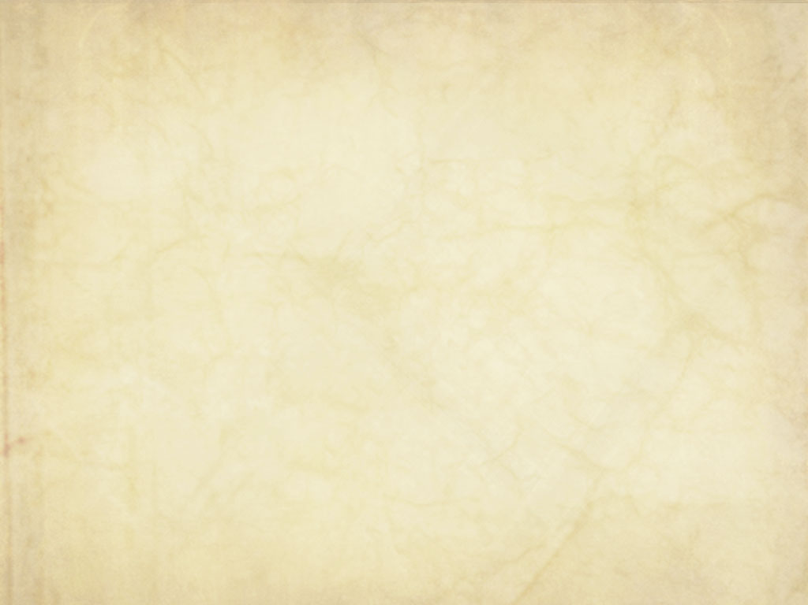
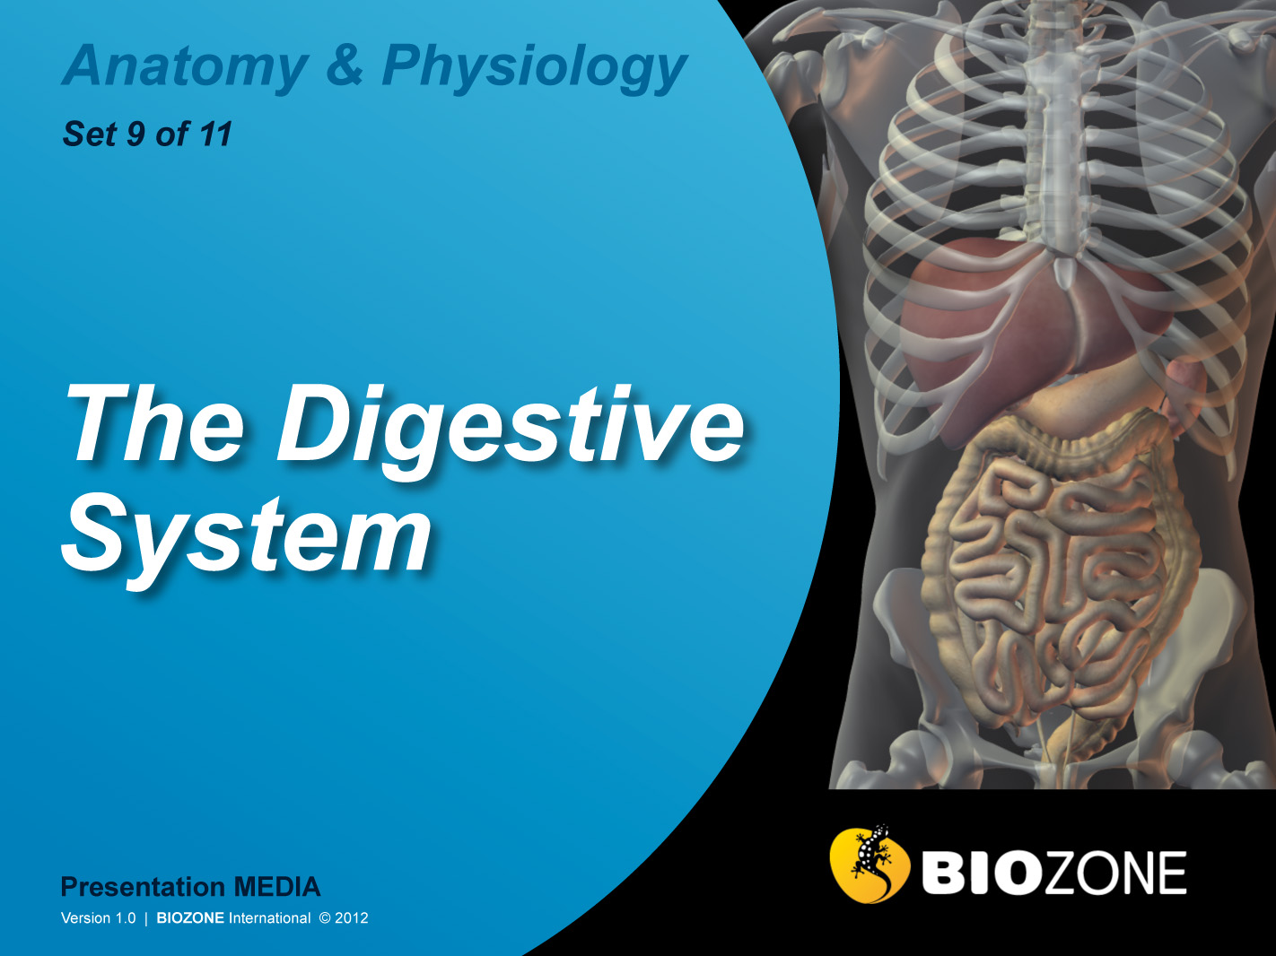

Slide 2
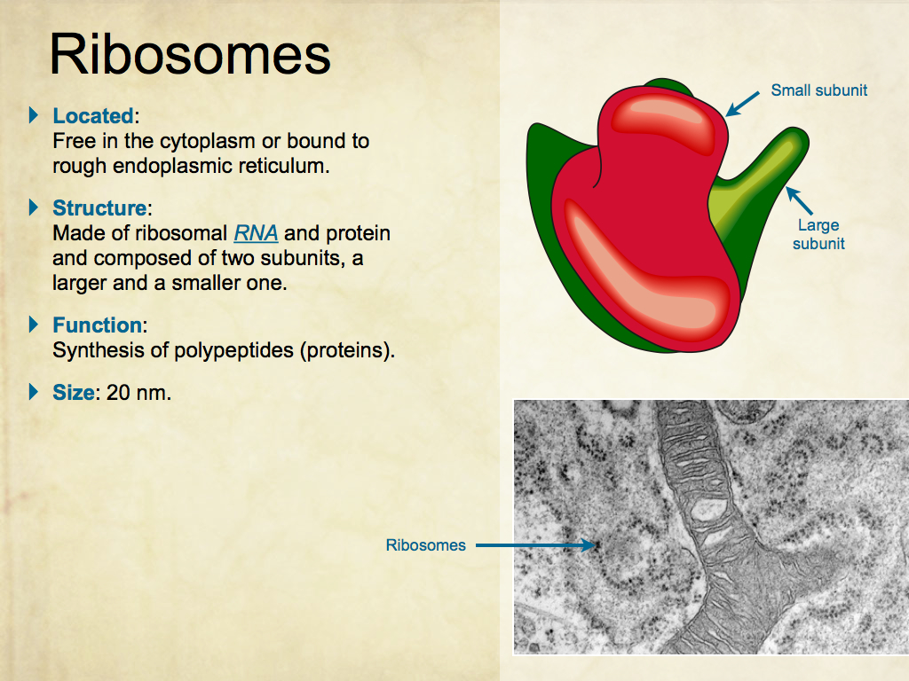
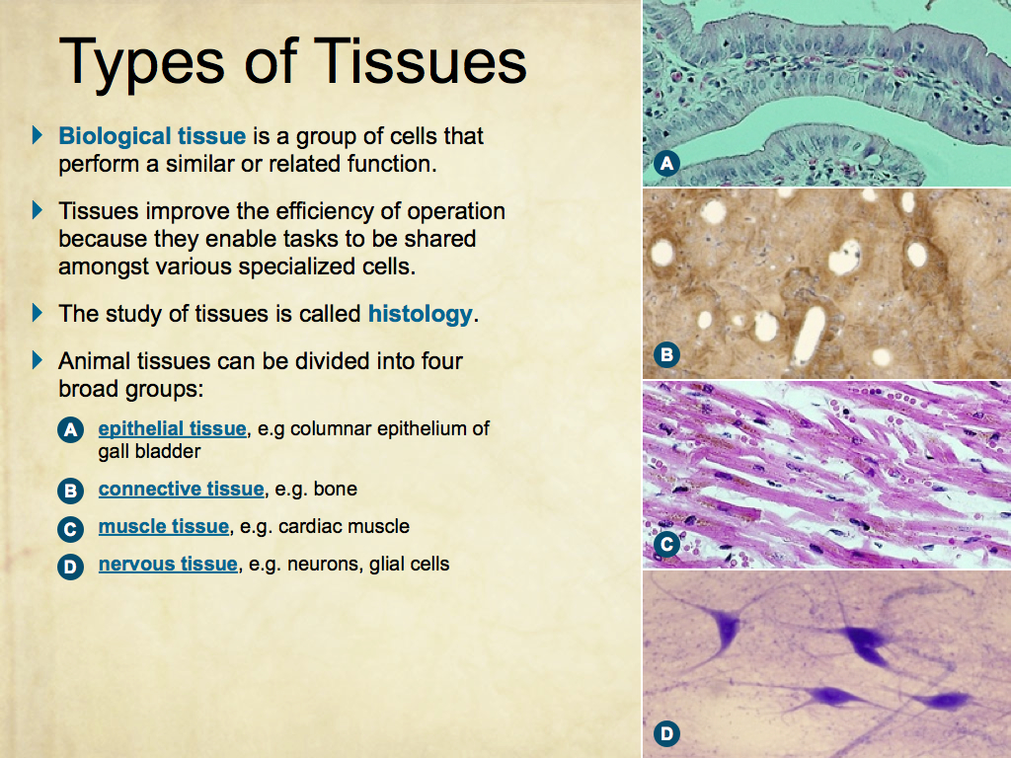
Using Presentation Media
BIOZONE Presentation Media
can be used either as a simple slide show or as an interactive lesson.
  Hyperlinks within the text take you to related slides.
Italicized hyperlinks link to the glossary of definitions.
Bold hyperlinks give direct access to specific slides.

Slide 3
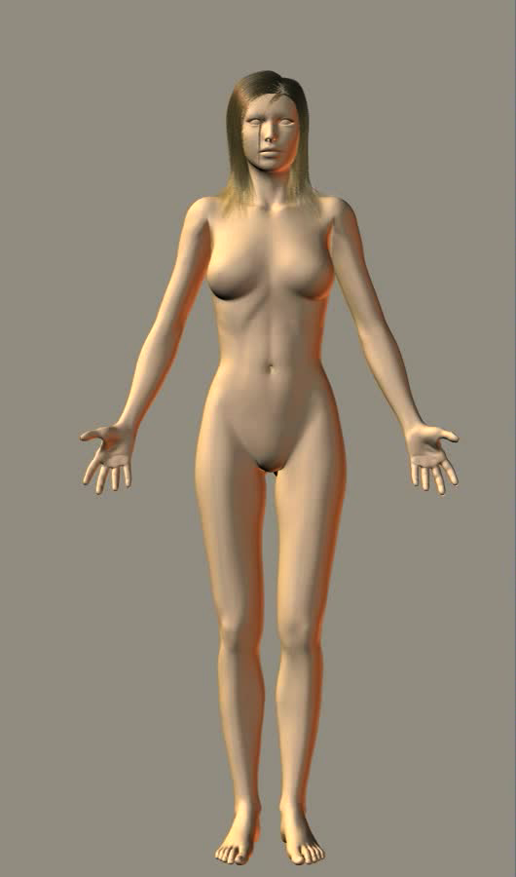
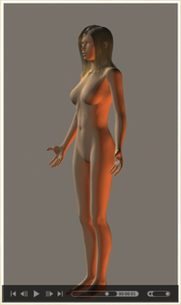
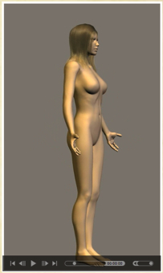
Using Presentation Media
BIOZONE Presentation Media can be used either as a simple slide show or as an interactive lesson
  The movie player allows you to rotate objects.
The movie loops continuously when activated
Use the movie controls in Keynote or Powerpoint
Pause the movie, then drag the slider to rotate the object back and forth

Slide 4
Introduction
  Interacting Systems
  Contexts
Food and Diet
  Food pyramid
  Vitamins
  Proteins
  Carbohydrates
  Lipids
  Body mass index
  Deficiency diseases
  Gut infection
The Digestive System
    The oral cavity
    Control of digestion
    The stomach
    Pancreas and gall bladder
    The small intestine
    The large intestine
    The liver
    Metabolism
Glossary

Slide 5
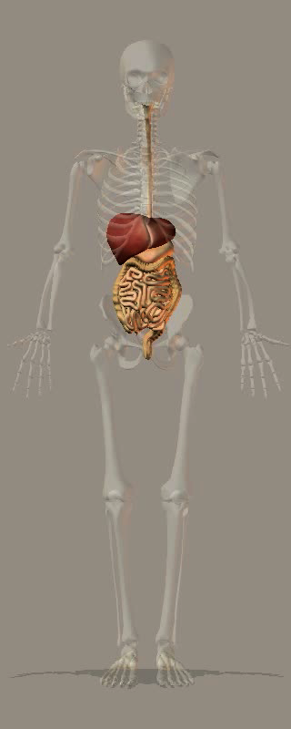
The Digestive System
The role of the digestive system to ingest food, digest it, absorb nutrients from the food, and eliminate undigested material.
The organs of the digestive system can be divided into two groups:
  Those that make up the gastrointestinal (GI) tract itself: mouth pharynx, esophagus, stomach, small intestine, large intestine rectum, and anus.
  Accessory organs: tongue, salivary glands, pancreas, liver, and gall bladder.
The GI tract performs all digestive functions.
The accessory organs assist in digestion, e.g. through secretion of enzyme-rich fluids.

Slide 6
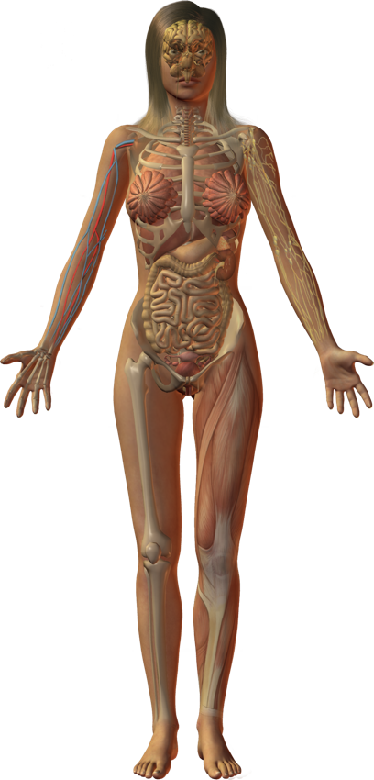
Interacting Systems
Nervous system
Endocrine system
Cardiovascular system
Respiratory system
Lymphatic system and immunity
The digestive system is responsible for the digestion and absorption of ingested food.
Ultimately, it provides the nutrients required for all metabolism, including the growth, repair, and maintenance of tissues.
Nutrients may be stored (e.g. in bone, liver, and adipose tissue).
The interactions of the digestive system with other systems are described on the following slides.
Urinary system
Reproductive system
Integumentary system
Skeletal system
Muscular system

Slide 7
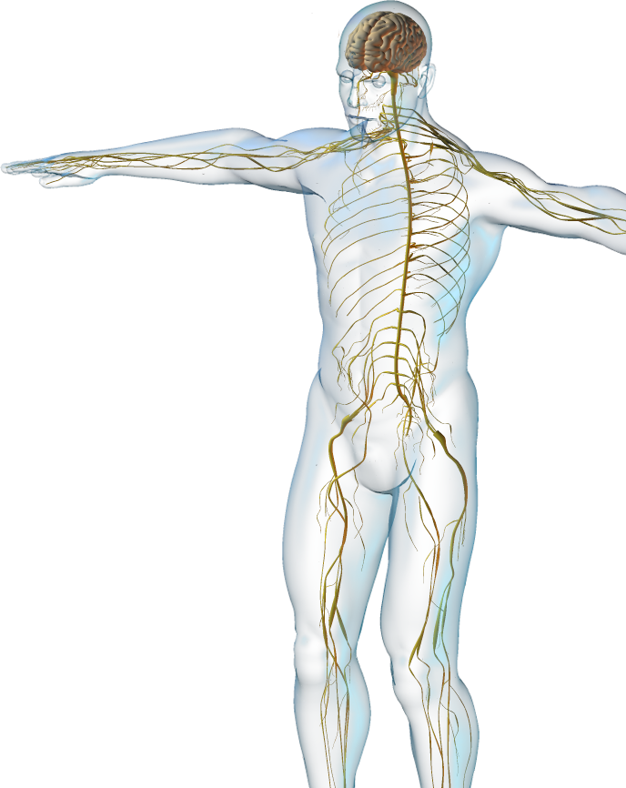



Nervous System
+
–
The digestive system interacts with the nervous system.
  The feeding center of the hypothalamus stimulates hunger. The satiety center suppresses the feeding center's activity
  after eating.
  Autonomic NS activity regulates much of gut function. Generally, parasympathetic stimulation increases and sympathetic stimulation decreases gut activity.
  There are reflex and voluntary controls
  over defecation.

Slide 8
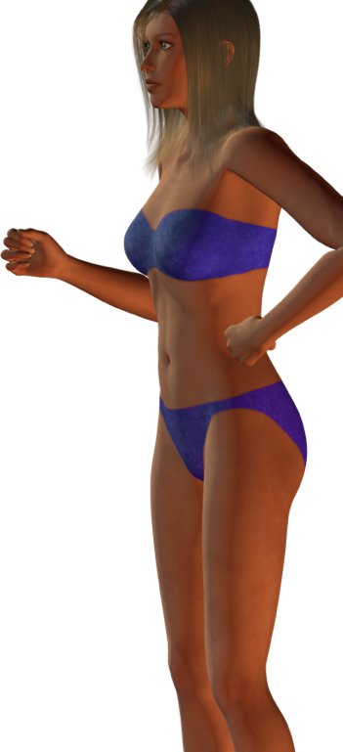
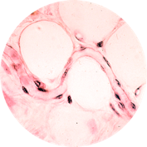
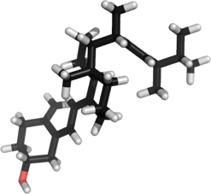
Integumentary System
The digestive system interacts with the integumentary system.
  Digestive system provides fats for insulation in dermal and subcutaneous tissues.
  Skin provides external covering to protect the digestive organs.
  The skin synthesizes the precursor to vitamin D, which is required for absorption of calcium from the gut.
Fat cells
Vitamin D

Slide 9
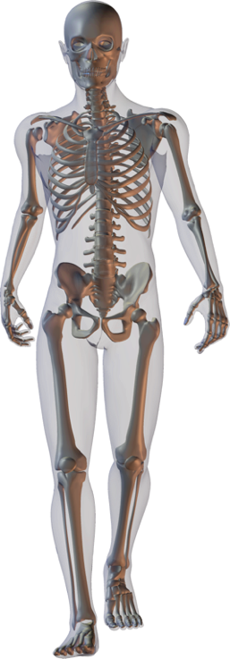
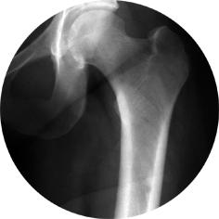
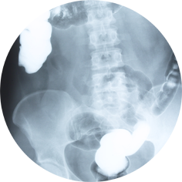
Skeletal System
The digestive system interacts with the skeletal system.
  Digestive system absorbs calcium needed for bone maintenance, growth, and repair.
  Skeletal system protects some of the digestive organs from trauma.
  Bone acts as a storage depot for some nutrients (e.g. calcium).

Slide 10
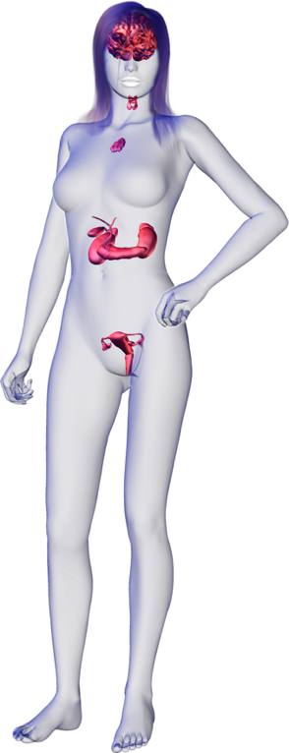
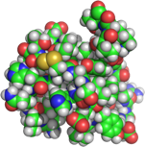
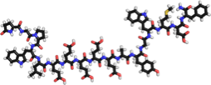
Endocrine System
The digestive system interacts with the endocrine system.
  The liver removes hormones from circulation and prevents their continued activity.
  The pancreas contains endocrine cells that produce hormones for regulating blood glucose levels.
  Local hormones help to regulate digestive secretions and gut motility
    gastrin from the stomach.
    cholecystokinin and secretin from the intestinal mucosa.
Insulin
Gastrin

Slide 11
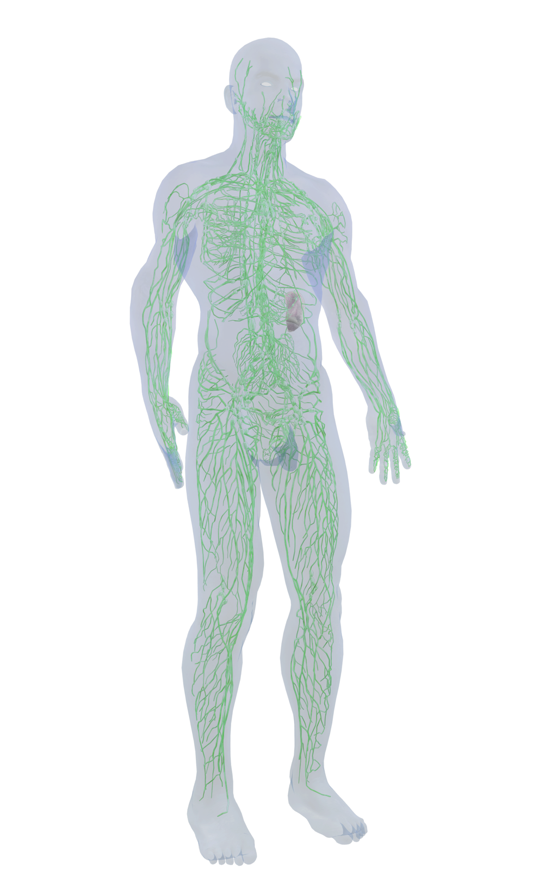
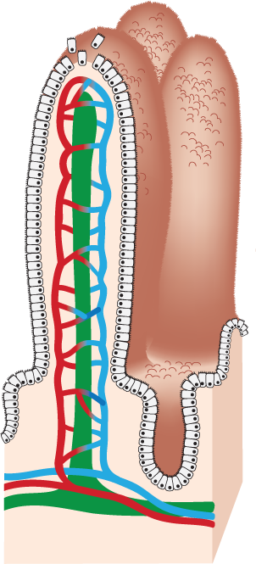
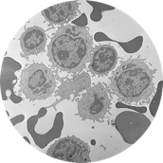
Lymphatic System
The digestive system interacts with the lymphatic and immune systems.
  The lymphatic vessels of the small intestine (the lacteals) drain fat-laden lymph from the gut to the liver.
  Acidic gastric secretions destroy pathogens (non-specific defense).
  Lymphoid tissues in the gut mesenteries and intestinal wall house macrophages and leukocytes that protect against infection.
Leukocytes

Slide 12
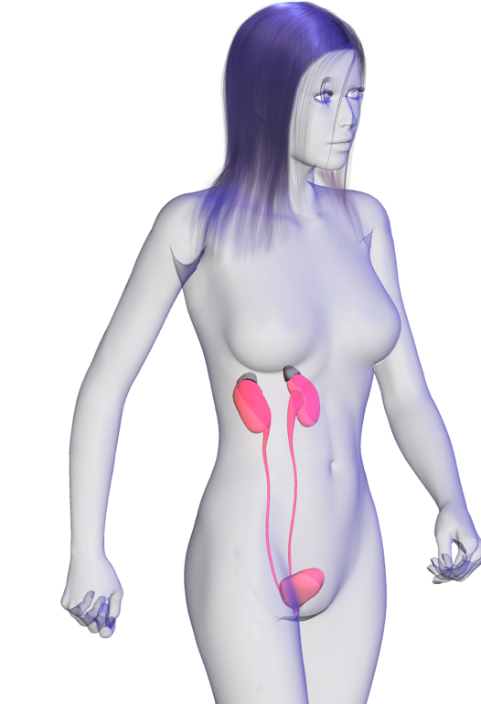
Urinary System
The digestive system interacts with the urinary system.
  Kidneys excrete toxins and the breakdown products of hormones which have been metabolized by the liver.
  Final activation of vitamin D, which is involved in calcium and phosphorus metabolism, occurs in the kidneys.
Vitamin D

Slide 13
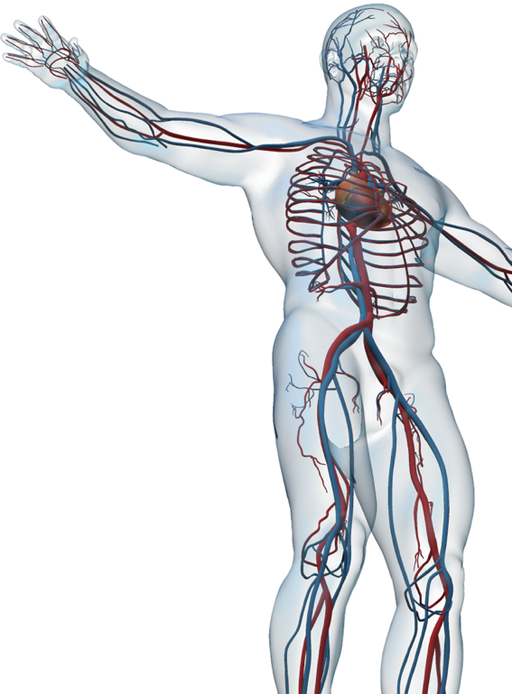
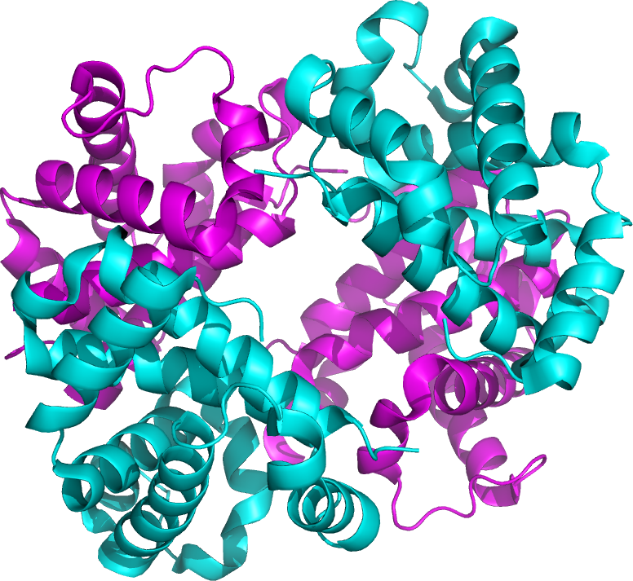
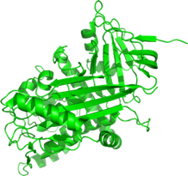
Cardiovascular System
The digestive system interacts with the cardiovascular system.
  Digestive system absorbs iron required for synthesis of hemoglobin, and water for maintenance of blood volume.
  Hepatic portal system transports nutrient-rich blood from substantial parts of the gastrointestinal tract to the liver. Ultimately the cardiovascular system distributes nutrients throughout the body.
  The liver produces angiotensinogen, a precursor of the protein angiotensin, which is involved in regulating blood pressure and fluid volume.
  Blood distributes hormones of the digestive tract.
Hemoglobin
Angiotensinogen

Slide 14
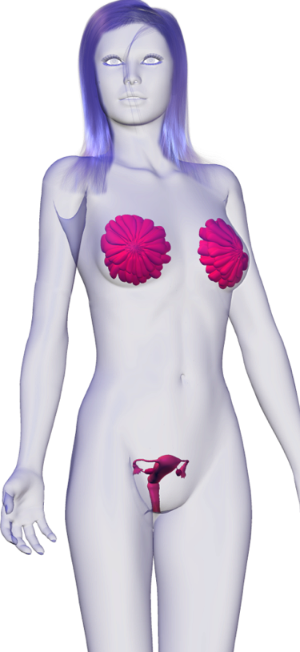
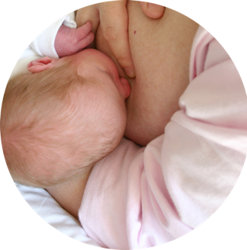
Reproductive System
The digestive system interacts with the reproductive system.
  The digestive system provides nutrients required both for normal growth and repair, and the extra nutrition required to support pregnancy and lactation.
Breast feeding

Slide 15
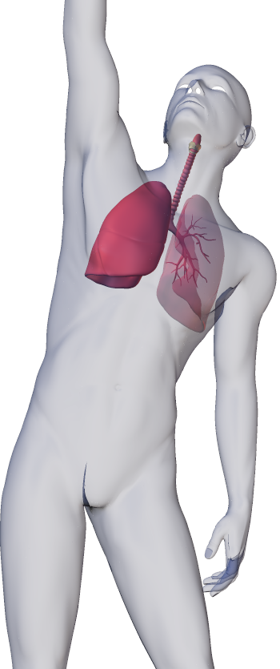
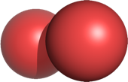
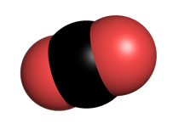
Respiratory System
The digestive system interacts with the respiratory system.
  Respiratory system provides O2 to the organs of the digestive system and disposes of CO2 produced by cellular respiration.
O2
CO2

Slide 16
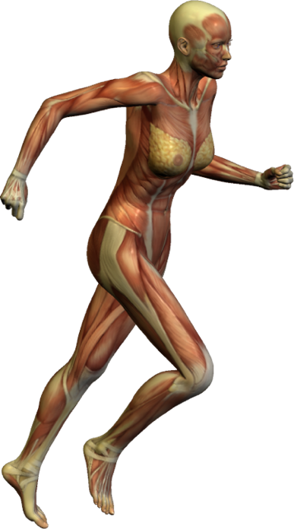
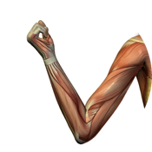

Muscular System
The digestive system interacts with the muscular system.
  Liver metabolizes lactic acid produced by intense, anaerobic muscular activity.
  Calcium absorbed in the gut as part of the diet is required for muscle contraction.
  The activity of skeletal muscles increases the motility of the gastrointestinal tract, aiding passage of food through the gut.

Slide 17
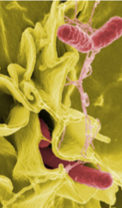
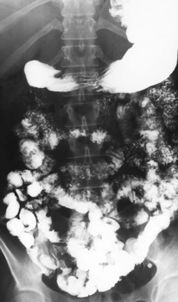
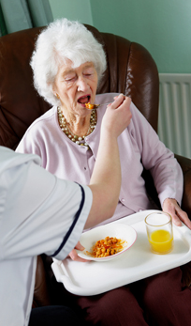
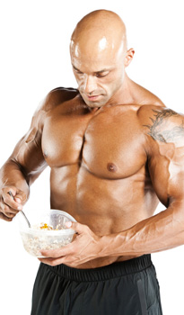
Contexts
Disease
What are the diseases of the digestive system and what are their symptoms?
Medicine and Technology
How do we prevent, diagnose, and treat diseases of the digestive system?
Eating to Live
The Digestive System
The digestive system provides for the energy and nutritional needs of all the body’s systems.
While the digestive system is fairly robust against degenerative changes, gastrointestinal disorders are common. Gut function is improved by moderate exercise.
PHOTO: NIH
PHOTO: PC
The Effects of Aging
How does aging affect the digestive system?
Exercise
What are the effects of exercise on the digestive system?
PHOTO: iStock
PHOTO: iStock

Slide 18
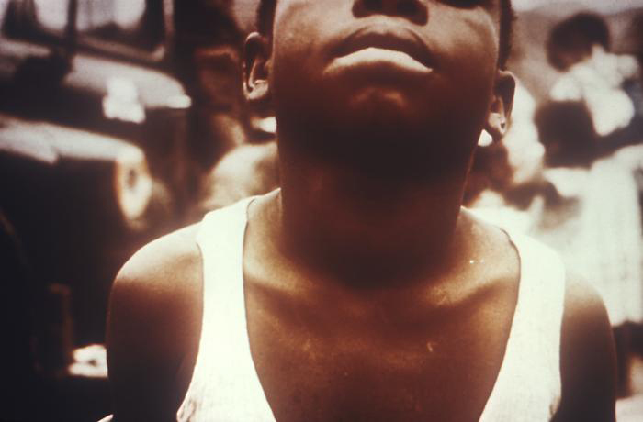
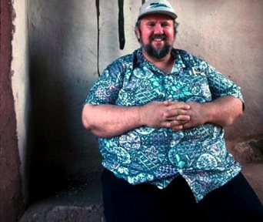
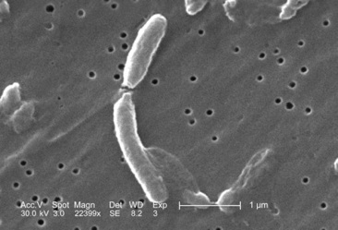
Disease
The digestive system is constantly exposed to potential pathogens or their toxins, resident on or in the food ingested each day.
Some types of food, when regularly eaten in large amounts, can cause irritation of the digestive system which can lead to disease.
Symptoms displayed by affected people can be used to diagnose the type of disease.
Goiter may be a symptom of iodine deficiency
CDC
Obesity can lead to diabetes
AT
Vibrio cholerae is a gut pathogen and the cause of cholera
CDC

Slide 19
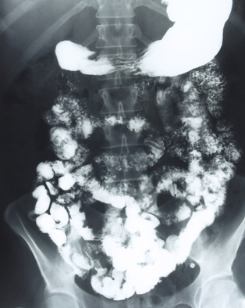
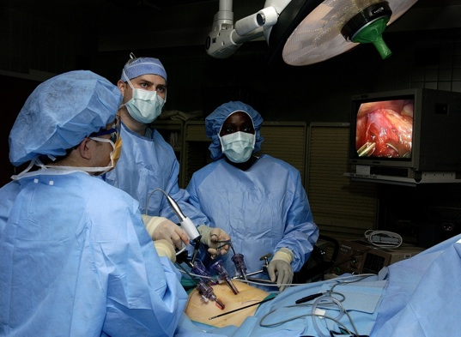
Medicine and Technology
Medical technology is now capable of preventing, treating or minimizing the effects of many diseases of the digestive system.
Medical imaging and surgery techniques, such as laparoscopy, have made it easier to diagnose and treat disease or repair or remove damaged structures.
PC
Removal of gallstones by laparoscopic surgery.
Photo: USAF

Slide 20
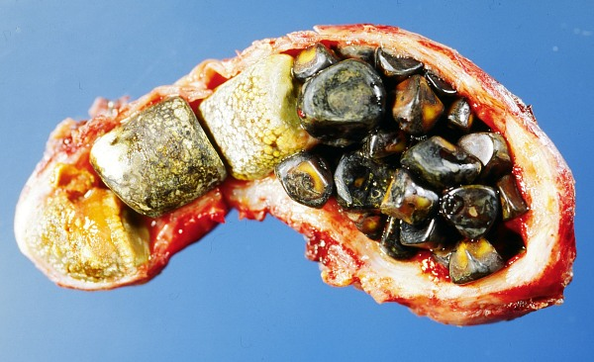
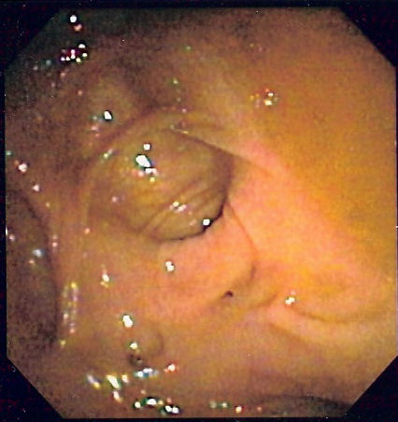
Effects of Age
The organs of the digestive system begin to fail as people grow older, resulting in a decrease the efficiency with which food is processed and absorbed.
As a result, the number of disorders of the digestive system experienced by the elderly increases.
  Among people aged between 55-65, 10% of men and 20% of women are affected by gallstones.
  Around 50% of those aged over 60 have diverticular disease (out-pocketing of the colon wall).
Diverticular disease viewed with an endocope showing how the bulge in the colon wall obstructs the gut lumen.
Gallstones completely filling the interior of a resected gall bladder
Photo: Emmanuelm CC3.0
Photo: The scope CC 3.0

Slide 21
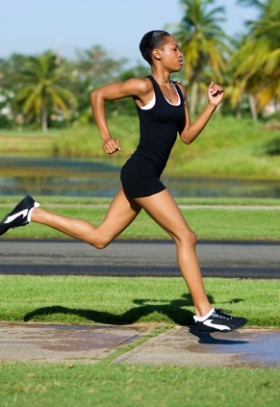
Exercise
Exercise has both short and long term effects on the function of the digestive system.
Maintaining a reasonable level of exercise can help maintain gut function in the long term, but excessive exercise can cause short term problems.
Gut transition time under different exercise regimes
70
60
GJ Oettlé. Dept Surgery Baragwanath Hospital
50
Whole gut transition time (hrs)
Time taken for a radio-labelled pellet to transit the gut was reduced under a regime of exercise. The ten subjects (colored lines)both ran and rode to account for the effect of “jiggling” the stomach contents when running.
40
30
20
Rest
Run
Ride
Regime
iStock
iStock

Slide 22
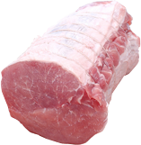
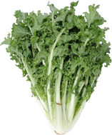
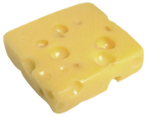
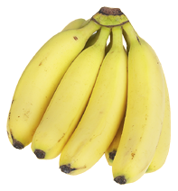
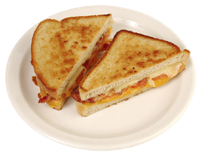





A Balanced Diet
Nutrients are required for metabolism, growth and repair of the body, and as a source of energy.
  Good nutrition is regarded as the key factor in good health.
  Conversely poor nutrition (malnutrition) may cause illness or disease.
A diet refers to the quantity and nature of the food eaten. Different foods contain different combinations of nutrients.
Water constitutes a high proportion of most fresh foods and not all foods contain all the representative nutrients.
Eating a wide variety of foods provides the balance of nutrients necessary for the body to function effectively.
All photos: CA

Slide 23




Dietary Recommendations
Dietary recommendations during the 1990s emphasized a high carbohydrate diet and reduced fat intake.
This was expressed as a food pyramid, which ranked common food groups according to the proportions that should occur in a balanced diet.
Oil and fats, sweets, and table sugar
EAT LEAST
Key to symbols
Fat (including added)
Sugar (added)
Milk, cheese, yogurt, and other dairy products
Fish, meat, nuts, eggs
2-3
Number of servings per day
S
Use these foods sparingly
Vegetables and fruit
Pasta, breads, cereals and grains
EAT MOST
All photos: CA

Slide 24








The ‘New’ Food Pyramid
New dietary recommendations distinguish between healthy and unhealthy types of carbohydrates and fats. A high intake of plant oils is correlated with reduced rates of heart disease.
Key to symbols
Multivitamin for most
2-3
Number of servings per day
Hemera
S
Use these foods sparingly
MM
Include at most meals
AB
Use in abundance
CA
Alcohol in moderation

Slide 25




Vitamins
Vitamins are a group of complex organic
substances that are essential in small
amounts for the normal functioning of the body.
There are 13 vitamins: A, B1, B2, B5 (pantothenic acid), B6, B7 (biotin), B12, C, D, E, K, niacin, and folic acid.
With the exception of vitamin D and niacin, the body cannot manufacture these substances and we must obtain them from food.
Vitamin D is produced in skin exposed to the UVB component of sunlight. Niacin is produced from the breakdown of the amino acid tryptophan.
The role of vitamins is not fully understood, but they are critical to many metabolic processes, including the activity of many enzymes for which they are cofactors.
Vitamin C (ascorbic acid)
Citrus fruits are a traditional source of vitamin C
All photos: CA

Slide 26
Daily Requirements
The daily requirement or vitamin, minerals and other nutrients changes depending on a person’s age and activity.
  Health organizations publish recommended intakes to meet the daily requirements of the average person. These may be expressed differently in different countries.
  Depending on the activity level the requirements will vary from person to person within the groups indicated below.
Age range | Vitamin A(µg) | Vitamin B7(µg) | Vitamin C(mg) | Vitamin D(µg) | Calcium (mg) | Iodine (µg/kg/day)
0-6 months | 180 | 5 | 25 | 5 | 300 | 15
1-3 years | 200 | 8 | 30 | 5 | 500 | 6
4-6 years | 200 | 12 | 30 | 5 | 600 | 6
7-10 years | 250 | 20 | 35 | 5 | 700 | 4
10 -18 years | 330-400 | 25 | 40 | 5 | 1300 | 2
Males
19-65 years | 300 | 30 | 45 | 5 | 1000 | 2
Females
19-65 years | 270 | 30 | 45 | 5 | 1000-1300 | 2
Pregnant women | 370 | 30 | 55 | 5 | 1200 | 3.5
Lactating women | 450 | 35 | 70 | 5 | 1000 | 3.5
Source: Recommended intakes WHO/FAO

Slide 27




















Using Food
Energy production
Glucose is the major source of energy for cells. Fats can be broken down to provide energy when carbohydrate supplies are depleted. Protein will supply energy if other supplies are exhausted.
Liver
The three biochemical food groups are proteins, lipids, and carbohydrates.
  Proteins are broken down into
  amino acids.
  Lipids make up membranes in and around cells, store energy and provide protection for organs.
  Carbohydrates are broken down to provide glucose, which is the primary fuel for energy yielding pathways.
Proteins
Body cells
Lipids
Carbohydrates
Polarlys
Liver cells
EII
Dividing body cells
Muscle cells
Growth and repair
Amino acids recombine to form new proteins. Lipids are involved in the formation of membranes. Carbohydrates supply energy.
WMU
Energy storage
Surplus carbohydrates are converted into glycogen and stored in the liver and muscle cells. Fatty acids provide a concentrated store of energy.
Fat cells
UD

Slide 28





Proteins
Antibodies are part of the immune system
Proteins are macromolecules consisting of many amino acids linked together by peptide bonds.
They play important roles in the body and can be divided into seven categories:
  Immunological, e.g. antibodies
  Contractile, actin and myosin in muscle fibers
  Storage, ferritin an iron storage protein
  Structural, e.g. collagen a component of connective tissue
  Transport, e.g. hemoglobin transports oxygen in the blood
  Catalytic, e.g. protein kinase
  Signalling, e.g. peptide and protein hormones and transmembrane receptors
WMU
Actin and myosin in muscle fibers
Ferritin subunit
Image:Zephyris CC 3.0
Hemoglobin transport oxygen
Collagen in connective tissue
Calcium dependent protein kinase II

Slide 29






Proteins in the Diet
Proteins in the diet supply the body with amino acids which are then reassembled by the body into new proteins.
  Without sufficient protein, the body breaks down muscle tissue to retrieve amino acids.
Proteins supply the body with 17 kilojoules of energy per gram.
Animal derived protein such as meat, poultry, eggs, fish, milk, and cheese provide all of the essential amino acids required by the body.
  Plant foods each have their own unique
  (but incomplete) amino acid profile. They can supply all the essential amino acids providing a wide variety of plant foods are eaten (not necessarily in the same meal).
All photos: CA

Slide 30



Protein Categories
Proteins can be categorized according to their structure:
  Globular proteins
  Fibrous proteins
α-chain
Fibers form due to cross links between collagen molecules
disulfide bond
β-chain
Human insulin (above) is an example of a small globular protein. It consists of two chains held together by disulfide bridges between neighboring cysteine (Cys) molecules.
Collagen (above) is an example of a fibrous protein. It consists of three helical polypeptide chains wound around each other. Hydrogen bonding between glycine residues holds these chains together.

Slide 31


Carbohydrates
Carbohydrates are a family of organic molecules made up of carbon, hydrogen, and oxygen atoms. Some are small, simple molecules, while others form long polymers.
Carbohydrates have the general formula Cx(H2O)y.
Simple carbohydrates are generally called sugars.The most common arrangements found in sugars are:
  Pentose, a five sided sugar, e.g. ribose and deoxyribose.
  Hexose, a six sided sugar, e.g. glucose and fructose. A structural formula and symbolic form are shown.
  In solution, these naturally form rings rather than straight chain structures.
Deoxyribose
6
Glucose
1
4

Slide 32


Carbohydrates in the Diet
Carbohydrates are important in the body for providing both energy and fiber.
  Starches are easily digestible and provide energy. Starches provide about 17 kJ or energy per gram (similar to proteins).
  Fiber such as cellulose, which makes up the bulk of plant material, cannot be digested by humans. The role of dietary fiber (roughage) is to provide bulk to food residue in the small intestine by absorbing water.
    Fiber may soluble or insoluble. Soluble fiber absorbs water forming a gel that binds material together. Insoluble fiber passes through the digestive system largely intact.
  Bulking may aid the intestinal system by:
    Providing better grip for colon walls to move and compress feces.
    Binding harmful chemicals.
    Decreasing intestinal transit time of food residues.
Hardened feces in colon
Constipation may result from a low fiber diet
Photo: James Heilman CC 3.0
Whole grain cereals provide a large amount of fiber.
CA

Slide 33



Role of Carbohydrates
Carbohydrates have several other key roles in the body:
  Protein sparer:
    Carbohydrate as glucose is the main energy source for the body. Failure to receive adequate carbohydrates triggers glucose synthesis from protein.
  Metabolic primer:
    By-products from the break down of carbohydrates facilitate the break down
    of fats.
  Fueling the central nervous system:
    The brain and other nervous tissue require glucose as an energy source. After about 8 days of low glucose intake, the brain adapts to using fats as an alternate fuel.
Effects of diet on muscle endurance
200
High carbohydrate diet
150
Time to exhaustion (min)
100
Balanced diet
High fat diet
50
All photos CA
Initial muscle glycogen (g.100 g muscle⁻¹)
0
1
2
3
4
A classic experiment by Bergstrom et al. on the effects of diet on the endurance of the quadriceps femoris muscle. High carbohydrate diets produce almost three times the endurance of a low carbohydrate diet. Endurance athletes today use this concept when “carbo-loading” before an event.

Slide 34


Carbohydrates - Glycogen
Glycogen is and extensively branched polysaccharide.
Glycogen is the energy storage compound of all mammals.
It is more water soluble than starch and is found mainly in liver and muscle cells, which are both centers of high metabolic activity.
Glycogen is readily hydrolyzed by enzymes to release glucose.
1,6 bonds
Symbolic form of glycogen
VA-Maryland Regional College of Veterinary Medicine
Glycogen is abundant in metabolically active tissues such as liver (left) and skeletal muscle (right). The glycogen stains dark magenta.

Slide 35
Lipids
Lipids are a group of organic compounds with an oily, greasy, or waxy consistency.
  Like carbohydrates, lipids contain carbon, hydrogen, and oxygen. However, in lipids, the proportion of oxygen is much smaller.
  They are relatively insoluble in water and tend to be hydrophobic (water repellent).
  Lipids are soluble in organic solvents such as ethanol and ether.
  Typical lipids, e.g. neutral fats, consist of fatty acids and glycerol (below).
H
O
H
C
OH
HO
C
CH2 CH2 CH2 CH2 CH2 CH2 CH2 CH2 CH2 CH2 CH2 CH2 CH2 CH2 CH2 CH2 CH2 CH3
O
H
C
OH
HO
C
CH2 CH2 CH2 CH2 CH2 CH2 CH2 CH2 CH2 CH2 CH2 CH2 CH2 CH2 CH2 CH2 CH2 CH3
O
H
C
OH
HO
C
CH2 CH2 CH2 CH2 CH2 CH2 CH2 CH2 CH2 CH2 CH2 CH2 CH2 CH2 CH2 CH2 CH2 CH3
H
Glycerol
Three fatty acids

Slide 36


Role of Lipids
Lipids can be classified as:
  simple lipids: fats, oils, and waxes
  phospholipids and related molecules
  steroids
Lipids have many roles, including as:
  biological fuels
  hormones
  structural components of membranes
Fats provide twice as much energy as carbohydrates or proteins.
Proteins and carbohydrates can be converted into fats stored in adipose tissue.
Plasma membrane
WMU
Phospholipids are the primary structural component of all cellular membranes, such as the plasma membrane (false color TEM above).
Fat cell
Capillary
Dept. Biological Sciences, University of Delaware
Lipids are often stored in special adipose tissue, within large fat cells (above).

Slide 37



Biological Roles of Lipids
The white fat tissue (arrows) is visible in this ox kidney
CA
TG
CA
COR
Fat absorbs shocks. Organs that are prone to shocks (e.g. kidneys) are cushioned with a relatively thick layer of fat.
Lipids are a source of metabolic water. Stored lipids can be metabolized for energy, producing water and carbon dioxide.
Stored lipids provide insulation in extreme environments. Increased body fat reduces heat losses to the environment.

Slide 38


Biological Roles of Lipids
DS
CA
SEM
WMU
Lipids are concentrated sources of energy and can be broken down to provide fuel for aerobic respiration.
Waxes and oils, provide lubrication and some waterproofing of hair.
Phospholipids form the structural framework of cellular membranes, e.g. the plasma membrane (arrowed).

Slide 39


The Body Mass Index
There is no specific weight that can be regarded as ideal, as everyone is different.
However the body mass index (BMI) is used as a measure of the general weight condition for people.
Body mass index =
(BMI)
weight of body (in kg)
height (in meters) squared
BMI | Condition
< 17 | Extremely underweight
17 - 19 | Underweight
19 - 25 Normal weight range
25 - 30 | Overweight
30 - 40 | Obese
40 < | Extremely obese
CA
CA

Slide 40


Obesity
Obesity is the most common form of malnutrition in affluent societies.
A person is considered obese if their body mass index figure is 30 or higher.
In Britain and the US, 20-30% of adults fall into this group.
AT
The man pictured here is clinically obese. Obesity places a strain on all the body’s organ systems.

Slide 41

Causes of Obesity
Obesity is generally caused by consumption of more calories than are burned through work, exercise, and other activities.
  Some individuals are obese because of specific physiological problems such as a malfunctioning thyroid or pituitary gland.
  Physical problems or disabilities that severely limit or prohibit exercise, strenuous work, and other physical activity.
  Dieting is often ineffective for long-term weight loss because once normal eating is resumed the body responds by storing more fat in the depleted fat cells.
Obese people may feel isolated or uncomfortable in public.
AT

Slide 42

Obesity:
Health Risks
Stroke
Hormonal imbalances
Breathing problems and lung diseases
Obesity always results in premature death, unless the sufferers weight is lowered.
Hypertension, heart disease, and Type 2 diabetes.
Gall bladder disease
In women, the menstrual cycle may become irregular.
Increased risk of cancers of the rectum and colon, and breast and cervix in women.
Arthritis and other skeletal problems
iStock

Slide 43


Type 2 Diabetes Mellitus
In this form of diabetes, the pancreas produces insulin, but not enough to meet the body’s needs, usually because the body’s cells lack sufficient insulin receptors and become less sensitive to normal amounts of insulin.
  Type 2 is the most common form of diabetes, accounting for 90% of all cases.
  Onset is gradual and it most often occurs in people who are over 40 and overweight. It is often termed adult onset diabetes.
  Symptoms are similar to type 1 diabetes, but are milder and the disease often goes undiagnosed.
  The high blood glucose levels are usually treated by dietary management and antidiabetic drugs.
Hemera
Electronic blood glucose testing kit for self monitoring of blood sugar levels

Slide 44

Diabetes and Health
The long term health problems associated with chronic, poorly managed diabetes include:
  Cataracts and vision loss as sugars attach to the lens of the eye
  Gangrene
  Cardiovascular disease
  Kidney damage, including glomerulosclerosis (right). This is associated with the appearance of protein in the urine (proteinuria) Protein leaks into the urine when the kidneys cease to function effectively.
Photo: CDC/ Dr. Edwin P. Ewing, Jr.
Histopathology of kidney showing nodular glomerulosclerosis characteristic of diabetes mellitus. The name of the disease refers to the scarring of the functional units of the kidneys (the glomeruli). Note the enlargement and distortion of the normally rounded glomerulus arrowed in the photograph.

Slide 45

Risk Factors for Type 2
The risks of developing type 2 diabetes are increased by:
  Obesity: BMI greater than 27. Distribution of weight is also important.
  Age: Risk increases with age, although the incidence of type 2 diabetes is increasingly reported in obese children.
  Sedentary lifestyle: Inactivity increases risk through its effects on bodyweight.
  Family history: There is a strong genetic link for type 2 diabetes. A family history of the disease increase the risk.
  Ethnicity: Certain ethnic groups are at higher risk of developing of type 2 diabetes.
  High blood pressure: Up to 60% of people with undiagnosed diabetes have high blood pressure.
  High blood lipids: More than 40% of people with diabetes have abnormally high levels of cholesterol and similar lipids in the blood.
iStock

Slide 46

Deficiency Diseases
Deficiency results from not eating enough of the right kinds of food and therefore not obtaining the appropriate balance of vitamins and minerals.
Children are most at risk of deficiency diseases because they are growing rapidly and assimilating a great proportion of their food.
  Malnutrition is a key factor in the deaths
  of 6 million children each year, mostly in developing countries.
Deficiencies of vitamins or minerals produce specific symptoms in sufferers.
Vitamins |  | Minerals
A |  | Calcium
B1 |  | Copper
B2 |  | Chlorine
B3 |  | Iodine
B5 |  | Iron
B6 |  | Magnesium
B12 |  | Manganese
C |  | Molybdenum
D |  | Potassium
E |  | Phosphorus
H |  | Selenium
K |  | Sodium
Pantothenic acid |  | Zinc
Folic acid
CA

Slide 47



Vitamin A Deficiency
Vitamin A (found in animal livers, eggs, and dairy products) is essential for the production of light-absorbing pigments in the eye and for forming cell structures.
Symptoms of vitamin A deficiency include:
  loss of night vision
  inflammation of the eye
  corneal damage
  Bitot’s spots (foamy patches on the white of the eye) as shown above right.
CDC
Vitamin A
Istock

Slide 48


Vitamin B12 Deficiency
Vitamin B12 (found primarily in meat, but also in eggs and dairy products) is required for:
  nucleic acid metabolism
  protein metabolism
  maturation of red blood cells.
  correct nervous system function
Deficiency results in pernicious anemia, poor appetite, weight loss, growth failure, fatigue, brain damage, nervousness, muscle tics, depression, spinal cord degeneration, and lack of balance.
CDC
Vitamin B12

Slide 49


Vitamin C Deficiency
Vitamin C deficiency causes a disease known as scurvy.
Scurvy is rare in developed countries because of increased consumption of fresh fruit and vegetables.
Inadequate vitamin C intake disturbs the body’s normal production of collagen, a protein component of the connective tissues that hold body structures together.
Symptoms of scurvy include poor wound healing, rupture of small blood vessels, swollen gums, and loose teeth.
CDC
Vitamin C

Slide 50


Vitamin D Deficiency
Femur
Patella
Tibia
Fibula
Lack of vitamin D in children produces the disease rickets. In adults, a similar disease is called osteomalacia. Both can lead to permanent bone deformities.
Vitamin D is necessary for absorption and utilization of calcium and phosphorus and promotes bone mineralization.
If calcium is in short supply, the body metabolizes it from the skeleton. Vitamin D is needed to restore the bone matrix.
Foot
Photo: Clipart.com
X-ray showing the bowing of the long bones of the legs, typically seen in children with rickets.
Vitamin D

Slide 51

Iodine Deficiency
Iodine is essential for the production of thyroid hormones.
Thyroid hormones control growth, development, and metabolic rate.
Deficiency of iodine in the diet may lead to goiter (enlargement of the thyroid).
Iodine deficiency is also responsible for some cases of thyroid underactivity.
The daily recommended intake of iodine is 150-200 μg.
CDC
Goiter
In 1954, Croatia introduced mandatory iodization of salt to reduce the incidence of goiter in school children. After ten years, the incidence of goiter had decreased significantly.

Slide 52

Iron Deficiency
Hemoglobin
β chain
α chain
Iron in the diet is required to produce hemoglobin, the oxygen-carrying molecule within red blood cells.
A lack of iron in the diet can cause lower than normal levels of hemoglobin in red blood cells. This results in anemia.
People most at risk include pregnant women and those with low dietary intakes of iron or absorption problems.
Symptoms include fatigue, fainting, breathlessness, and heart palpitations.
Image:Zephyris CC 3.0
Each Hb can bind four O2 molecules
CA

Slide 53

Calcium Deficiency
Tibia (shinbone)
Calcium is found in dairy products and fish.
It is required for:
  enzyme function
  the formation of bones and teeth
  blood clotting
  muscular contraction
Calcium deficiency causes:
  poor bone growth and structural weakness(increasing the tendency of bones to fracture and break)
  muscular spasms
  reduced blood clotting ability
Fibula
Fracture
Foot
CA

Slide 54

Alcohol Abuse and Nutritional Deficiency
Regular consumers of alcohol are at increased risk of nutritional deficiencies.
Even when food intake is adequate, alcohol interferes with the metabolism of food by affecting digestion, storage, utilization, and excretion of nutrients.
Alcohol inhibits fat absorption, impairs the digestion of proteins, and interferes with glucose metabolism.
Common nutrient deficiencies in alcoholics include: thiamin, riboflavin, vitamin B12, folate, vitamins A, C, D, and K, iron, calcium, magnesium, and zinc deficiencies.
iStock

Slide 55

Kwashiorkor
Kwashiorkor is a form of malnutrition occurring in children as a result of a diet deficient in protein and energy.
A nursing infant obtains the amino acids required from its mother's milk.
  When weaned on to a diet lacking in milk or meat, the child is at risk of kwashiorkor.
Kwashiorkor occurs most often in overpopulated parts of the world where the diet consists mainly of starchy vegetables.
  Prevalent in Africa, Central and South America, and South East Asia.
  In developed countries, it is most often associated with neglect
This child shows many of the obvious signs of kwashiorkor
CDC

Slide 56


Symptoms of Kwashiorkor
A child suffering from kwashiorkor typically appears emaciated but has a swollen abdomen. The hair appears reddish because of loss of pigment.
  Other signs of the disease include edema of the limbs, diarrhea, enlargement of the liver, and abdominal bloating.
  The edema associated with kwashiorkor is related to a lack of albumin (soluble protein) in the blood. Plasma proteins help to retain fluid within the blood vessels. Low plasma proteins levels result in fluid leaking out and accumulating in the tissues.
Pitting edema in the swollen limbs of a child with kwashiorkor
CDC
This child has the pale, reddish hair, puffy face, and listless appearance of kwashiorkor
CDC

Slide 57

Marasmus
Marasmus is the most common form of deficiency disease globally.
It is a severe form of protein and energy malnutrition that usually occurs in famine or starvation conditions.
Children suffering from marasmus are stunted and extremely emaciated.
Unlike kwashiorkor, marasmus does not cause the bloating and elongation of the abdomen. However, sufferers have no resistance to disease and common infections are typically fatal.
CDC
A Nepalese child with severe marasmus

Slide 58


Infectious
Diseases
Infectious disease of the digestive system include:
  Cholera
    Cholera is extremely infectious. Its toxin affects ion transport in the intestinal cells leading to the loss of large quantities of water with the feces.
  Viral hepatitis
    Liver inflammation can result from five unrelated hepatitis viruses labeled A-E.
  Bacterial food poisoning
    Incorrectly prepared food can cause food poisoning by pathogens such as Salmonella and Camplyobacter.
  Viral gastroenteritis
    Can be caused by Rotavirus, Adenovirus, Astrovirus and Norovirus. Norovirus, in particular, is extremely infectious.
Salmonella
NIH
Campylobacter. Note the flagellated, spiral shaped cells.
CDC

Slide 59


Diagnosis of Disorders
There is a wide range of techniques available to medical practitioners today to help with diagnosis:
  Endoscopy and colonoscopy.
    Miniaturization and fiber optics allow for medical equipment to perform surgery and take biopsies without the need for major surgical operations.
  Gastrointestinal biopsy.
  MRI scans and barium enema X-ray.
    MRI allows for extremely accurate three-dimensional scans of the body’s organs and tissues. Barium sulfate helps to increase contrast in X-ray images.
  Blood tests.
    Blood tests can help to diagnose many disorders including dietary deficiencies.
Photo: Kd4tt CC2.5
Polyp on the wall of the colon (arrowed)
COR
Endoscopic examination of the abdominal interior

Slide 60


Gut Infection
Image: Agricultural Research Service X10,000
The gut contains a large bacterial flora, with possibly up to 1000 species.
Some may have a mutualistic relationship with humans, manufacturing some nutrients (e.g. vitamin K). Most are harmless in the gut environment.
Under certain conditions, including immune deficiency, some can cause infections or cancer (e.g. Helicobacter is associated with stomach ulcers).
Pathogenic bacteria, introduced via contaminated food or water, may cause gut irritation, vomiting and diarrhea.
E. coli is a common gut bacterium
CDC
Bacteroides biacutis makes up about 30% of the normal gut flora.

Slide 61

Managing Gut Flora
Use of broad-spectrum antibiotics can destroy normal gut flora leaving patients vulnerable to infection by rapid growth of potentially pathogenic species, e.g. Campylobacter and Clostridium difficile.
If the normal gut flora is severely depleted, new bacteria can be introduced by fecal transplant (via enemas or delivery by nasogastric tube).
Mild disruption of the gut flora can be helped by ingesting probiotics in tablets or fermented foods such as yoghurt.
  The bacteria Lactobacillus acidophilus is a probiotic commonly found in yoghurts and fermented drinks. It occupies the gut wall and prevent colonization by pathogenic species. Probiotics are bacteria that convey a benefit to the host gut.

Slide 62


Cholera
Cholera is an acute intestinal infection caused by the bacteria Vibrio cholerae.
The bacterium produces an enterotoxin which causes the gut to lose copious quantities of water into the gut lumen, resulting in severe diarrhea and dehydration.
Cholera toxin
Subunit A
(toxin)
Subunit B
(binds with cell membrane)
Dartmouth Electron Microscope Facility
Vibrio cholerae bacterium

Slide 63








Mechanism of Action
Cell interior
Gut lumen
ATP
Subunit B of the toxin binds to the plasma membrane of the intestinal epithelial cell.
Subunit A enters the cell and activates pathways that cause the production of cAMP from ATP.
cAMP activates the Cystic Fibrosis Transmembrane conductance Regulator (CFTR) channel.
Cl⁻ is lost through the channel into the gut lumen.
Na⁺ follows down its electrochemical gradient.
H2O follows by osmosis.
cAMP
Cl⁻
Na⁺
H2O

Slide 64


Treating Cholera
Cholera can be treated by the use of oral rehydration solutions (ORS).
Modern ORS are simple and inexpensive. They contain water and salts in specific ratios designed to replenish lost fluids and electrolytes.
Carbohydrates, such as glucose, are added to enhance electrolyte absorption.
With prompt treatment the fatality rate from cholera is less than 1%.
Unicef
Mother learning to administer ORS at a training camp

Slide 65



ORS Mechanism
Na⁺
Glucose
Gut lumen
Cell interior
Glucose and sodium enter the gut lumen in high concentrations.
  These are transported into the cell by the sodium glucose symport (ion pump).
  The influx of Na+ ions causes a positive charge in the cell interior, resulting in chloride ions moving into the cell down their electrochemical gradient.
  Water reenters the cell by osmosis, and then into the blood, restoring blood volume.
  This effect can happen rapidly, but treatment must continue until the immune system has eliminated the cholera bacteria.
Na+ - Glucose symport
Cl⁻
H2O

Slide 66

The Digestive Tract

Slide 67


The Digestive Tract
7
7
Anus
1
4
Appendix
2
4
Large Intestine
3
Esophagus
4
6
6
Gall bladder
5
Liver
6
11
11
Oral cavity
7
5
Pancreas
8
8
10
Rectum
9
10
3
Small intestine
10
Stomach
11
3
2
2
9
9
1
Anterior view
Posterior view
1

Slide 68

The Oral Cavity
The oral cavity forms the start of the digestive system.
The mouth is formed by the cheeks, hard and soft palate, and the tongue.
Teeth are structures specialized for masticating (chewing) food.
The tongue, along with the lower jaw, moves food around the mouth to
aid physical break down by chewing.
Salivary glands add saliva during chewing to moisten food and aid digestion.
CA

Slide 69

The Oral Cavity
Superior lip
Superior labial frenulum
Gingivae (gums)
Hard palate
Soft palate
Cheek
Uvula
Palatoglossal arch
Palatine tonsil
Tongue
Molars
Premolars
Canine
Inferior lip
Incisors

Slide 70

The Oral Cavity
Nasal cavity
The interior of the oral cavity is lined with tough nonkeratinized squamous epithelium.
The tongue is the body’s most flexible muscle and is connected to the floor of the mouth by the frenulum (at the front) and to the lower jaw and hyoid bone at the rear.
Soft palate
Hard palate
Tonsils
Oral cavity
Uvula
Pharynx
Tongue
Epiglottis
Teeth
Jaw
Trachea
Esophagus

Slide 71


Salivary Glands
Salivary glands are located towards the rear of the oral cavity, and below the tongue.
They produce salvia, which moistens both food in the oral cavity and the oral cavity itself, and contains the enzyme amylase, which breaks starch into maltose.
Mucous cells
Intralobular duct
Parotid gland
Submandibular gland
Sublingual gland
COR
Section through a submandibular gland

Slide 72

Swallowing
The features of the mouth and pharynx allow swallowing or breathing, but not at the same time.
As swallowing begins, the epiglottis is lowered so that food is directed down the esophagus.
The tongue and muscles at the back of the throat contract to force food into the esophagus.
Automatic reflexes then squeeze the food down the esophagus into
the stomach.
Breathing is possible through the nose and mouth when the epiglottis is raised.
When swallowing, the epiglottis is lowered, directing food into the esophagus. Breathing is not possible during this time.

Slide 73

Teeth
The mouth is divided into quadrants
The number of teeth in each quadrant is given by the dental formula.
  The dental formula is written for one side of the mouth as I:C:P:M or incisors: canines: premolars: molars, with upper and lower quadrants on separate rows.
Molars: there are four groups of three molars in adults. They are used as the main grinding surface in the mouth.
Premolars: there are four groups of two premolars in an adult. They combine features of the canines and molars, providing an intermediate tooth during chewing.
Canines: There are four canines in adults. They are primarily used for gripping food, although they are highly reduced in humans relative to carnivores.
Incisors: The are eight incisors in adults. In humans they are primarily used for biting, shearing, and cutting food.
The dental formula for this mouth is:
2:1:2:3
2:1:2:3

Slide 74




Teeth
Crown
Molar showing crown, cusps, and roots
There are 32 permanent teeth in adults.
Teeth fit inside sockets in the maxilla (upper jaw) and mandible (lower jaw), and are secured by periodontal ligament tissues attached to the roots.
Deciduous teeth begin to be lost at around 8 years of age, at which time the permanent teeth appear to replace them.
Roots
Photo: KPryor
Cusps
Premolar showing distinctive double cusps
Photo: KPryor
Deciduous teeth showing inner pulp region.
Mandible
Photo: TG

Slide 75

Wisdom Teeth
Wisdom teeth usually appear between the age of 20 and 30.
  They are often extracted as there usually not enough room in the oral cavity for them.
  Wisdom teeth often become impacted as they move through the gum. Impacted teeth can cause chronic pain and inflammation in the gum.
Erupted and unimpacted wisdom tooth
Drilled and capped tooth
Erupted and unimpacted wisdom tooth
Inflamed area
Impacted area
Image: courtesy Steve Evens
Unerupted and impacted wisdom tooth
Partially erupted and slightly impacted wisdom tooth
Courtesy Steve Evens
Right
The dental formula for this mouth is:
2:1:1:3
2:1:2:2
2:1:1:3
2:1:1:3
Left

Slide 76


Tooth Structure
The portion of the tooth above the gum is termed the crown. The part embedded into the jaw is termed the root.
Dental filling
The crown is covered with enamel, the hardest substance in the body.
Crown
Photo: KPryor
Dentine is a softer layer beneath the enamel that makes up the bulk of the tooth.
Tooth decay is the result of the breakdown of the enamel by acids produced by bacteria on the tooth surface.
Root
The pulp cavity contains nerves and blood vessels.

Slide 77

Processing Food
Ingestion: Food is taken in through the mouth as large particles.
Mastication: Large particles are broken up and mixed with saliva.
Digestion: Most digestion occurs after chewing by the action of enzymes acting on the food.
Absorption: The products of digestion can be absorbed across the gut lining. Lower in the gut, salts and water are also reabsorbed.
Egestion: Undigested material and the waste products of digestion are formed into feces and eliminated by defecation.

Slide 78




Mechanical Digestion
In the mouth the teeth chew and grind food into smaller pieces, mixing in saliva to start digestion.
Mechanical digestion breaks food down into smaller parts using physical movements of the body.
  The teeth grind food.
  The stomach mixes and churns food.
  The intestines squeeze and move food.
CA
The stomach continues to churn food and mix in digestive juices.
Peristaltic waves squeeze and move food through the
intestinal tract.
PC
PC

Slide 79








Carbohydrate Digestion
Chemical digestion starts in the mouth where the enzyme amylase in saliva begins the breakdown of starch into maltose.
Maltose
Starch
Amylase is also released by the pancreas and digestion continues in the small intestine.
Enzymes produced by the intestinal epithelial cells include dextrinase, glucoamylase, lactase, maltase, and sucrase. They break down oligosaccharides and disaccharides into monosaccharides.
Pointing to colon?
Galactose
Fructose
Glucose
Maltose is further broken down by the enzyme maltase, produced by the intestinal epithelial cells. The disaccharides lactose and sucrose are also broken down into their monosaccharides (glucose and galactose, and glucose and fructose respectively).

Slide 80

Protein Digestion
The stomach lining is dotted with pits that secrete hydrochloric acid and digestive enzyme precursors. Pepsin is activated in the presence of hydrochloric acid and begins the breakdown of proteins by hydrolysis.
Protein
Pepsin
Amino acids
Enzymes from the pancreas break down proteins into their constituent amino acids. The most important of these is the enzyme trypsin. It too breaks down proteins by hydrolysis.
Peptide bond
OH is added to the carboxyl end
Water
The intestinal epithelial cells also produce enzymes to help protein digestion, including aminopeptidase and dipeptidase.
H is added to the amine end
Hydrolysis breaks down proteins by adding water across the peptide bond

Slide 81







Lipid Digestion
A small amount of lipid digestion occurs in the stomach by the action of gastric lipase.
Fats (triglycerides)
Fats are emulsified (broken into small droplets of <1mm) in the small intestine by bile salts to increase the surface area for lipase action.
Lipase
Monoglyceride
Pancreatic lipase (from pancreatic juice) hydrolyses triglycerides into fatty acids and monoglycerides.
Fatty acids

Slide 82
Enzymes and Digestion
Enzyme secretions and their role in digestion
Secretion and source | Site of action | Active enzyme | Substrate and products | Control of secretion
Gastric juice: stomach | Stomach | Pepsin | Protein Peptides | Reflex stimulation, stretching of the stomach wall, and the hormone gastrin
Pancreatic juice: pancreas (exocrine region only) | Duodenum | Pancreatic amylase Trypsin Chymotrypsin Pancreatic lipase | Starch maltose Protein peptides Protein peptides Fats Fatty acids + glycerol | Control of pancreatic secretions is via release of the hormones secretin and cholecystokinin
Intestinal juice and enzymes: small intestine | Small intestine | Maltase Peptidases | Maltose glucose Polypeptides amino acids | Reflex action and contact with intestinal wall

Slide 83


Nervous Control of Digestion
Salivation is under nervous control. Some saliva is secreted continuously in response to parasympathetic stimulation via the vagus nerve.
The feeding center in the hypothalamus is constantly active. It monitors metabolites in the blood and stimulates hunger when metabolites are low.
Vagus nerve
After a meal the satiety center suppresses the activity of the feeding center.
The presence of food in the mouth stimulates the salivary glands (and stomach) to increase their secretions. This operates through a cranial reflex via the vagus nerve.
Impulses from the feeding center and satiety center travel via the vagus nerve to stimulate the secretion of particular digestive hormones.

Slide 84


Effect of CKK and Secretin
The entry of food into the small intestine stimulates the cells of the intestinal mucosa to secrete the hormones cholecystokinin (CCK) and secretin.
Secretin stimulates the pancreas to increase its secretion of alkaline fluid. This neutralizes the acid entering the intestine. Secretin also stimulates the production of bile from the liver cells.
Cholecystokinin circulates in the blood and stimulates the pancreas to increase its secretion of enzyme-rich fluid. CCK also stimulates the release of bile into the intestine from the gall bladder.
Both CCK and secretin stimulate the secretion of intestinal juice but inhibit gastric secretion and general motility of the gastrointestinal tract.

Slide 85
Effect of Gastrin
The presence of food in the stomach causes it to stretch. This mechanical stimulus results in secretion of hormone gastrin from the cells in the mucosa of the stomach. This activity is mediated through a simple reflex.
Gastrin is secreted in response to food. Gastrin is released into the bloodstream where it acts back on the stomach to increase gastric secretion and motility.
Vagus nerve
Gastrin also increases the motility of the gastrointestinal tract and thus helps propel food through the gut.

Slide 86

The Stomach
The stomach is a muscular, J-shaped enlargement of the intestinal tract.
It connects the esophagus to the duodenum.
One of its functions is to store and regulate release of food into the duodenum.
It also acts as a mixing area, mixing acids and digestive enzymes into food to form chyme.
Stomach
Gall bladder
Pancreas
Duodenum

Slide 87

Stomach Structure
The stomach has four main areas: cardia, fundus, body and pylorus.
When empty, the wall of the stomach is folded into rugae (wrinkles).
The stomach is separated from the duodenum by the pyloric sphincter.
Three layers of muscle are embedded into the
muscle wall.
  Longitudinal layer
  Circular layer
  Oblique layer
Esophagus
Fundus
Cardia
A
B
Body
Pylorus
Lesser curvature
C
Pyloric sphincter
Greater curvature
Rugae
A
B
C
Duodenum

Slide 88


Histology of the Stomach
Gastric pit
Mucosa
Submucosa
The stomach wall is composed of the same four layers as the rest of the intestinal tract. They are:
  Mucosa
  Submucosa
  Muscularis
  Serosa
The surface of the mucosa is a layer of simple columnar epithelial cells.
The wall is pitted with gastric pits which contain gastric glands which secrete mucus and enzymes into the stomach.
Muscularis
EII
Serosa
Mucous surface cells
Gastric pit
EII

Slide 89



Histology of the Stomach
Gastric pit
Stomach surface
PC
CC
GC
Gastric pit
Goblet cells (GB)
Mucous neck cells
Image:Jpogi
Stomach epithelium
Parietal cells (PC)
Gastric gland
Chief cells (CC)
Gastric glands
Submucosa
Muscularis
Serosa
Enteroendocrine cell
Section through stomach wall

Slide 90


Stomach Cell Function
PC
CC
GC
Gastric secretions are controlled by gastric glands, which pit the lining of the stomach.
Chief cells in the glands secrete pepsinogen, a precursor of the enzyme pepsin.
Parietal cells produce hydrochloric acid, which activates the pepsinogen.
Goblet cells at the neck of the gastric gland secrete mucus to protect the stomach mucosa from the acid.
Enteroendocrine cells in the gastric gland secrete the hormone gastrin which acts on the stomach to increase gastric secretion.
Image:Jpogi
Parietal, chief, and goblet cells
Stomach epithelium

Slide 91


Pancreas and Gall Bladder
The pancreas and gall bladder provide digestive enzymes that enter the small intestine at the duodenum, the C-shaped section at the beginning of the small intestine.
Gall bladder
Acinar cells
Pancreas
Pancreatic duct
Duodenum

Slide 92
Pancreas
Section through pancreas
The pancreas is around 15 cm long and 2-3 cm thick.
It is divided into the head, located nearest the duodenum, the body and the tail.
Each day the pancreas produces around 1.3 liters of pancreatic juice, a clear colorless liquid containing salts, enzymes and sodium bicarbonate.
  The sodium bicarbonate raises the pH to about 8 and neutralizes the acid entering from the stomach.
  It also inactivates pepsin from the stomach and provides the correct pH
  for the digestive enzymes in the
  small intestine.
The endocrine portion on the pancreas (islets of Langerhans), is involved in blood sugar regulation but not in digestion.
The exocrine portion of the pancreas comprises rings of acinar cells surrounding small branches of the pancreatic duct. The acinar cells secrete pancreatic juice via the duct to the duodenum.

Slide 93


The Small Intestine
Gut lumen
Villus
The small intestine (SI) is made up of
three sections:
  Duodenum - the short C-shaped section at the beginning of the SI.
  Jejunum - the midsection of the SI. It is slightly thicker and short than the ileum, at about 2.5 m in an adult human.
  Ileum - the longest section of the SI, at about 3.5 m in an adult human.
The main function of the SI is to absorb nutrient molecules into the blood.
The SI is lined with villi, fingerlike projections that absorb nutrient molecules.
Section through small intestine
Villi along surface of the small intestine
DS

Slide 94
Detail of a Villus
The intestinal villi project into the gut lumen and provide an immense surface area for nutrient absorption.
The villi are lined with epithelial cells and each has a brush border of many microvilli which further increase the surface area.
Enzymes bound to the surface of the epithelial cells break down peptides and carbohydrate molecules.
Epithelial cells
Capillaries surround a central lymph vessel
Epithelial cells divide and migrate toward the top of the villus to replace lost and worn cells
Alkaline fluid and mucus
Nutrients are transported away
Crypt of Lieberkuhn

Slide 95


Villi and Microvilli
A section through the ileum reveals the projections of the intestinal villi and the dips of the intestinal glands (crypts of Lieberkuhn).
  The crypts of Lieberkuhn secrete mucus and alkaline fluid.
The products broken down by the enzymes in the surface of the microvilli are absorbed into the underlying blood and lymph vessels.
Goblet cells (GC) produce mucus to protect the epithelial cells from enzymatic digestion.
Villi
John Green
Intestinal gland
GC
Section through ileum
Microvilli
Dartmouth Electron Microscope Facility
Surface of intestinal epithelial cell

Slide 96

Absorption in the Small Intestine
Lumen of gut
Amino acids
Dipeptides
Short chain fatty acids
Long chain fatty acids
Tripeptides
Glucose/galactose
Monoglycerides
Active transport
Facilitated diffusion
Active transport
Fat soluble vitamins
Clumps of bile salts aid passage of lipids across the membrane of epithelial cells.
Diffusion
Fructose
Active transport
Diffusion
Intestinal epithelial cell
Protein coated aggregations of fats are formed in the Golgi of the epithelial cells.
Goblet cell
Cross section through a villus showing how the various breakdown products of digestion are absorbed across the intestinal epithelium into the capillaries of lacteals of the lymphatic system. These vessels eventually deliver these nutrients to the liver for processing.
Capillary
Vein
Lacteal

Slide 97

Transport
After absorption, nutrients are transported to the liver for processing via the hepatic portal system.
The liver obtains oxygenated blood via the hepatic artery, but it also receives deoxygenated blood carrying newly absorbed nutrients via the hepatic portal vein.
The hepatic portal system refers to all the blood that passes through the liver before returning to the heart.
The liver monitors and processes the nutrients in the blood before it passes into general circulation.
The hepatic portal system conveys blood from the entire digestive system to the liver.

Slide 98

The Large Intestine
Colon
After most of the nutrients have been absorbed in the small intestine the remaining fluid contents is passed to the large intestine (LI).
The LI comprises three main sections, the cecum, colon and rectum.
The fluid contains undigested or undigestable material, bacteria, dead cells sloughed off from the gut wall, mucus, bile, ions, and a large amount of water.
In humans the LI’s main function is to reabsorb water and electrolytes.
Taenia coli (longitudinal bands of smooth muscle running the length of the the LI)
Haustra (pouches along the colon)
Cecum
Appendix
Rectum
Anus

Slide 99

The Large Intestine
Transverse Colon
Colon: Absorbs water, Na⁺ and some vitamins. Also incubates bacteria (which provide vitamin K)
The semisolid waste from the colon is passed to the rectum where it is stored before being expelled (egested).
Infection or disease can result in not enough water being absorbed causing diarrhea.
Too much water being absorbed can lead to feces becoming hard and difficult to pass, resulting in constipation.
Ascending Colon
Descending Colon
Small intestine
Cecum
Rectum: Feces are stored and consolidated before elimination.
Appendix: a blind sac that may have a minor immune function.
Anus: Two anal sphincters control elimination. One is under involuntary control: stretching of the anus triggers its reflex relaxation. The other is under voluntary control allowing the reflex activity to be modified.

Slide 100


Large Intestine Histology
Simple columnar epithelial cell (EC)
Goblet cell (GC)
Crypt (C)
The lining of the large intestine consists of a simple columnar epithelium.
The epithelium is not folded into villi, but instead contain tubular glands called crypts containing numerous goblet cells.
The goblet cells produce mucus which lubricates the colon wall and aids the formation of feces.
Submucosa (SM)
Lymph nodule (LN)
Circular muscle (CM)
(SM)
(EC)
(LN)
(GC)
Lumen
(CM)
(C)
EII
Transverse section through wall of colon

Slide 101



Movement of Food
After ingestion muscular movements of the stomach mix and churn the food.
After 1-2 hours after eating, peristaltic contractions of the stomach move the contents (chyme) towards the pylorus.
Each contraction moves about 3 ml of chyme through the pyloric sphincter and into the duodenum.
1
Muscular movements churn food into chyme
2
3
The pyloric sphincter opens, letting food into the duodenum
Pylorus
Pyloric sphincter
Peristaltic waves move chyme into the pylorus

Slide 102




Movement of Food
After moving into the small intestine, chyme is moved along by peristalsis.
Circular muscle contracts behind the food and expands in front of it, producing a traveling wave.
Circular muscle contracts narrowing gut.
Chyme
Longitudinal muscles contract, shortening the gut ahead of the chyme.
The alternate contracting and relaxing of circular and longitudinal muscle sends a traveling wave along the gut, moving the chyme along.
1
2
3

Slide 103



Movement of Food
During segmentation alternate sections of muscle contract moving feces back and forth, causing mixing, but not propel them along the colon.
Most nutritional material has been removed from the food by the time it reaches the large intestine (LI).
Fecal matter moves more slowly through the LI than through the small intestine.
This enables up to 2 liters of water to be reabsorbed per day.
Movements along the LI include segmentation, peristalsis, and mass movements.
Peristalsis moves feces towards the rectum.
Extra strong peristaltic waves called mass movements move feces from the transverse colon into the rectum. These occur 2-3 times a day.

Slide 104

Symptoms of Disease
Symptoms of disease or infections of the digestive tract include:
  Pain (moderate to severe).
    Pain in the stomach may be caused by sickness, indigestion, stomach ulcers or cancers.
  Bleeding or change in bowel function.
    Blood in the feces is usually a sign of lower gastrointestinal bleeding. It may be associated with food poisoning, an ulcer, or cancer.
  Gastric reflux, nausea, vomiting, or diarrhea.
    Nausea and vomiting are often caused by the body’s response to a pathogen in the stomach and upper intestinal tract.
  Nutritional deficiencies.
    Malnutrition is becoming surprisingly common in the Western world as eating habits change.

Slide 105

Non Infectious Diseases
The digestive system can be affected a number of disorders.
  Bowel cancer.
    Bowel is the third most common cancer in the world, and is even more common in the developed world.
  Appendicitis.
    Caused by the obstruction of the appendix. An inflamed appendix often has to be removed by surgery.
  Inflammatory bowel diseases.
  Food allergies or intolerance.
    One of the most common food allergies is an allergy to nuts (e.g. peanuts). Lactose intolerance occurs when the enzyme lactase is not efficiently produced by the body.
  Cirrhosis of the liver.
  Deterioration of the liver as once healthy tissue is replaced by scar tissue.
Inflamed appendix
Ed Uthman CC2.0

Slide 106


Preventing and Treating Diseases
There is a range of treatments for dietary disorders, some require major surgery, others a simple change in diet.
  Drug therapies.
    Antibiotics are widely used to treat bacterial infections and are one stage in the treatment of cancerous tissue.
  Surgery.
    Surgery may be used to remove diseased tissue. Gastric bypass surgery is sometimes used as a radical means of weight-loss.
  Radiotherapy.
    Radiotherapies are commonly used in the treatment of cancers.
  Dietary management.
  Behavior modification.
    Greater knowledge of the effects of various kinds of food on behavior and the body have allowed people to live more healthy and productive lives.
PC
CA

Slide 107


Appendicitis
Obstruction of the appendix by fecal matter or some other cause can lead to an inflammation called appendicitis.
Appendicitis usually develops rapidly with little warning over a period of 6-12 hours.
The usual symptom is abdominal pain, accompanied by nausea, vomiting, and a slight fever.
Acute appendicitis is treated by surgical removal of the appendix (appendectomy).
The infected appendix can be removed by a standard operation or by laparoscopy.
The gastrointestinal system can operate perfectly well without the appendix.

Slide 108

Effects of Aging
As people age various digestive functions begin to slow down, or fail:
  Increased risk of bowel cancer.
    The average age at which bowel cancer is first noticed is 65.
  Slower passage of food, constipation.
    Low fiber diets and low exercise in elderly add to problems of the digestive system. Reduced muscle tone reduces the ability of the digestive tract to move food.
  Decline in gastric emptying rate.
    Reduced muscle tone reduces the ability of the digestive tract to move food.
  Reduced gastric capacity.
Wiki CC3.0
Colon cancer

Slide 109

The Liver
The liver is a large organ, weighing about 1.4 kg, and is well supplied with blood.
It carries out several hundred different functions, including a pivotal role in homeostasis.
In its digestion role, it produces the alkaline fluid bile, which is secreted at a rate of about 1 liter per day.
It is also responsible for processing absorbed nutrients, which arrive at the liver via the hepatic portal system.
The liver is the body’s largest internal organ and carries out important roles in both digestion and homeostasis.
Suseno

Slide 110


Histology of the Liver
Sinusoid
Central vein
The liver is divided into functional units called lobules.
Each lobule is classically described as being six sided with branches of the hepatic artery, hepatic portal vein and bile duct at each corner.
Each lobule consists of rows (cords) of hepatocytes (liver cells) arranged in a radial pattern around a central vein, which has no connective tissue surrounding it.
  Between the cords are blood spaces called sinusoids and small channels through which bile flows.
Radiating cords of hepatocytes
EII
Central area of liver lobule showing central vein
Portal tract (triad)
Central vein
Fibrous connective tissue capsule surrounds lobules
Bile duct
Flow of bile
Liver lobule
Branch of hepatic portal artery
Branch of hepatic portal vein

Slide 111


Structure of the Liver
Bile duct
Blood rich in nutrients from branches of the hepatic portal vein
Liver lobule
Oxygenated blood from branches of the hepatic artery
Blood from the hepatic artery and hepatic portal vein mix in the sinusoids and flow towards the central vein of the lobule
Simplified view of part of the a liver lobule to show the direction of blood and bile flow.
Blood vessels and sinusoids are lined with thin, sparse endothelial cells and Kupffer cells, which engulf microbes and break down spent red blood cells.
Central vein

Slide 112
Structure of the Liver
Bile duct
Bile canaliculus: Bile, produced by the hepatocytes, is secreted into channels (canaliculi), where it flows into the bile ductules and then into the bile duct.
The hepatocytes are relatively undifferentiated cells, rich in glycogen and tightly packed together in rows or cords. They are in contact with blood in the sinusoids.
The central veins from all lobules unite to form the hepatic vein which leaves the liver and enters the vena cava.
Central vein
Simplified view of part of the a liver lobule to show the direction of blood and bile flow.

Slide 113

Functions of the Liver
The production and secretion of bile is regulated through nervous and hormonal mechanisms.
The vagus nerve stimulates bile production
The hormone secretin stimulates bile production.
Secretin and cholecystokinin (CCK) are released into the blood from the intestinal mucosa in response to food (especially fat) in the small intestine.
Gallbladder stores bile, releasing it into the small intestine when required.
Sphincter of Oddi relaxes to release bile into the small intestine. Sphincter relaxation is stimulated by the hormone CCK.

Slide 114

Functions of the Liver
Bile is produced by liver cells and flows from small ducts into larger ones. Bile consists of water, bile salts, cholesterol, lecithin, bile pigments, and several ions.
Hepatic duct
The common bile duct transports the bile from the gallbladder where it is stored to the small intestine.
Pancreatic duct (from the pancreas joins with the the bile duct bringing pancreatic secretions)
The hormone cholecystokinin (CCK) stimulates the release of bile into the small intestine.

Slide 115

The Liver’s Role
The liver is the largest homeostatic organ.
It performs many important roles including:
  Production of bile.
  Storage and processing of nutrients.
  Detoxification of poisons and
  metabolic wastes.
The liver has a unique double blood supply with up to 20% of of the total blood volume flowing through it at any one time.

Slide 116




The Liver’s Homeostatic Role
Summarized briefly the liver:
  Secretes bile, important for emulsifying fats in digestion.
  Metabolizes amino acids, fats, and carbohydrates.
  Synthesizes glucose from non carbohydrate sources when glycogen stores are exhausted (gluconeogenesis)
  Stores iron, copper, and some vitamins (A, D, E, K, B12)
  Converts unwanted amino acids to urea (urea cycle).
  Manufactures heparin and plasma proteins
  (e.g. albumin).
  Detoxifies poisons or turns them into less
  harmful forms.
  Some liver cells phagocytose worn-out cells.
  Synthesizes cholesterol from acetyl coenzyme A.
Liver cells
EII
Alanine (amino acid)
Glucose
Cysteine (amino acid)

Slide 117

Protein Metabolism
Small Intestine
Amino acids
The most critical aspects of
protein metabolism occurring in the liver are:
  Deamination and transamination of amino acids.
  Removal of ammonia from the body by synthesis of urea
  Synthesis of non essential amino acids.
Protein synthesis
Deamination
Transamination
Keto acid + -NH2
Krebs cycle
Urea cycle
Plasma proteins
Urea (NH2)2CO
New amino acids
Blood

Slide 118
Carbohydrate Metabolism
Small Intestine
Small Intestine
Hexose sugars
Lipids
The liver has a central role in carbohydrate metabolism:
  The production of glucose from non-carbohydrate sources.
  The interconversion of glucose
  and glycogen.
These processes ensure that carbohydrate is stored and released as required.
The processes are regulated by the hormones insulin and glucagon, and also adrenaline and glucocorticoids.
Glycogenesis
+ insulin
Glycerol
(with amino acids)
Glycogen
Fats
Gluconeogenesis
+ adrenaline, glucocorticoids
Glycogenesis
+ Glucagon
Fatty acids
Glucose
Glycerol
Glucose
Blood

Slide 119
Storage and Detoxification
Small Intestine
Minerals
Vitamins
Hepatic portal blood
The liver is responsible for the breakdown or excretion of toxins and hormones.
  Alcohol is detoxified
  Drugs such as penicillin are excreted into the bile
The pigment bilirubin (derived from the heme of worn out blood cells) is absorbed from the blood by the liver and secreted into
the bile.
  Bilirubin is then metabolized by bacteria in the gut.
Storage of iron, copper, and fat soluble vitamins
Hemoglobin breakdown
Detoxification and/or breakdown by liver cells
Bilirubin excreted in bile
Hormones
Toxins
Iron
Blood

Slide 120


Cirrhosis of the Liver
Cirrhosis of the liver is a condition in which the liver deteriorates due to long term damage.
Scar tissue replaces damaged tissue, reducing the livers ability to regenerate new cells and to function correctly.
Cirrhosis is caused by:
  Heavy alcohol abuse
  Hepatitis C (and Hepatitis B and D to lesser extents)
  Autoimmune diseases (70% female)
  Obesity
Cirrhosis is usually diagnosed by biopsy using laparoscope (a type of endoscope).
Cirrhosis can be treated by changes in diet and drug therapies.
Photo: Ed Uthman
CDC
Cirrhosis of the liver, showing yellowing of liver tissue.

Slide 121


Exercise and Diet
The digestive system reacts to the level of exercise in various ways:
  Reduced blood flow to the gut during exercise.
    During long and intense exercise blood is redirected to the muscles. The gut temporarily becomes inactive.
  Improved digestive function over the long term.
    Exercise improves muscle tone which helps to keep the intestinal tract functioning smoothly.
  Gastrointestinal upset in highly trained athletes.
    Elite athletes often over stress the body, leading to muscle cramping. Extreme diets can further disrupt the digestive system.
Diet can have a major effect on the body’s ability to carry out physical tasks.
  Managing diet is just as important as any training regime.
    Different types of sport or exercise require different nutritional input if the body to perform at peak levels. e.g. body building requires a high input of protein.
CA

Slide 122
Amino acid | Organic compound consisting of a carboxyl, an amine and an R group (where R may be one of 20 different atomic groupings). Polymerized by peptide bonds to form proteins.
Anaerobic | Without oxygen. In anaerobic metabolism in muscle, the terminal electron acceptor in the respiratory pathway is lactic acid.
Anemia | Condition in which the number of red blood cells or their hemoglobin content is below normal.
ATP | Adenosine TriPhosphate. A nucleotide comprising a purine base, a pentose sugar, and three phosphate groups, which acts as the cell’s energy carrier.
cAMP | Cyclic Adenosine MonoPhosphate. Intracellular messenger formed from ATP.
Cofactors | Non-protein chemical compounds required for the biological activity of proteins. These proteins are most commonly enzymes.
Defecation | Elimination of feces - the undigested and unabsorbed end products of digestion.
Edema | An abnormal accumulation of fluid beneath the skin or in one or more cavities of the body.
Enterotoxin | A toxin that specifically acts on the cells of the intestinal mucosa.
Electrolyte | Substance containing ions that can dissociate in water to conduct electricity.
Emaciated | Extremely thin, such that skeletal structure is discernible through the skin.
Epithelium | A sheet of cells tightly bound together lining cavities and surfaces of structures in multicellular organisms.
Enzyme | A globular protein which acts as a catalyst to speed up a specific biological reaction.

Slide 123
Heme | A non-protein compound consisting of a iron atom bound within an organic porphyrin ring. It is central to the hemoglobin molecule that binds and transports oxygen in the blood.
Homeostasis | The relative physiological constancy of the body despite external fluctuations.
Hormone | A chemical messenger that induces a specific physiological response in a target tissue.
Hypothalamus | The liquid component of blood in which the blood cells are suspended. Consists mostly of water (93%) and various other dissolved chemicals including proteins, CO2, and hormones.
Insulin | A hormone produced by the pancreas that regulates the metabolism of carbohydrates and fats, especially in relation to blood glucose levels.
Lumen | The space with a tube-like structure, e.g intestine, artery, or vein.
Metabolism | Biochemical reactions that occur within a organism. They in both catabolic and anabolic reactions.
Pathogen | A disease-causing organism.
Parasympathetic nerves | A branch of the autonomic nervous system that generally has an inhibitory effect.
Polysaccharide | A large carbohydrate molecule made up of many monosaccharide units. Examples are starch and glycogen.
Sympathetic nerves | A branch of the autonomic nervous system that has generally excitatory effects.

Slide 124


Slide 125
Conditions of Use
NOTE: Presentation Media = presentations available on CD-ROM/DVD-ROM or as downloads
BIOZONE retains copyright to the intellectual property included in the Presentation Media files, with acknowledgement that certain photos are used under license and are credited appropriately.
You MAY:
Use the Presentation Media files for presentations in your classrooms using a
data projector, interactive whiteboard or overhead projector.
Place the Presentation Media files on any staff computer within the school,
including staff laptops, but not in contradiction to clause (g).
Place the Presentation Media files on:
  The school’s intranet (school computer network)
  VLE (Virtual Learning Environment)
  A CMS (Content Management System).
Student and staff access must be restricted to those who are enrolled/working on the campus of the registered purchaser. Student and staff access to a VLE or a CMS must be controlled by a user login and password protocol, but not in contradiction to clause (f). If students have access, they need to be made aware of the Conditions of Use and are only allowed to view the content.
Edit and customize the Presentation Media files by adding, deleting, and
modifying information to better suit your needs, but not in contradiction to
clauses (h) - (l).
Print out the Presentation Media files in PowerPoint® or Keynote®
“Handouts” mode for the express purpose of allowing students to make their
own notes about the presentation, but not in contradiction to clause (j).
You MAY NOT:
Place the Presentation Media files on to the Internet or on a service that may be
accessed off-campus unless access to the service is protected by a user login
and password protocol, and is restricted to students and staff enrolled/working on
the campus of the registered purchaser.
Place the Presentation Media files on student laptop computers.
REMOVE any of the references to BIOZONE, the title slides, copyright
notices, photo credits, or Conditions of Use from the Presentation Media
files.
Create a NEW document using any of the graphics/images in the Presentation
Media files.
Print the Presentation Media files on to paper to make your own worksheets for
distribution to students.
Incorporate any part of the Presentation Media files for the production of another
commercial product.
Share or give away any content off-campus. This prohibition apples to, but is not
limited to, sharing via the Internet or any website, (examples: YouTube, slide
sharing websites).
Conditions of Use are subject to change without notice. Visit www.thebiozone.com/conditionsofuse

Slide 126
Photo Credits
Photographic images are used under license from the following commercial photo libraries:
  Corel Corporation Professional Photos (uncoded)
  ArtToday.com (coded AT)
  Clipart.com (coded CA)
  PhotoObjects.com (coded PO)
  iStock.com (coded iStock)
  Hemera Technologies Inc. (coded Hemera)
  Photos.com (coded PC)
  Education interactive (coded EII)
  Visuals unlimited (coded UV)
  Waikato Microscope Unit (Coded WMU)
  Digital Stock (coded DS)
  LifeArt (coded LA)
3D models were created using Poser 8
Additional artwork and photographs are the property of BIOZONE International Ltd. All rights reserved.
Some 2D artwork has been adapted from TechPool STUDIOS LifeArt Collections, used under licence.
Images from the Public Domain: Where these licenses have been used, authors and licenses have been acknowledged alongside their image.
  Centers for Disease Control (coded CDC)
  National Institutes of Health (coded NIH)
  Images from the public domain include limited copyright,
  copyright expired, uncopyrighted, or uncopyrightable material:
    Licenses including: GNU Free Documentation License
    http://www.gnu.org/copyleft/fdl.html
    Creative Commons Attribution Share Alike
    http://creativecommons.org/licenses/by-sa/3.0/
    Wikimedia Commons
NOTE: Where images are edited or moved from or within this file, the accompanying photo credit must be retained.

Slide 127


